Slide 1
Sequential Logic
Imran Siddiqi
imran.siddiqi@mcs.edu.pk
Computer Science Department
College of Telecommunication Engineering
National University of Sciences and Technology

Slide 2
Analysis of Sequential Circuits
How to design machines that go through a sequence of events
Earlier we learned how to specify combinational circuits
  Truth tables, Boolean equations, …
Now extend to synchronous sequential circuits
  Include time
  Use ‘state tables’ and ‘state diagrams’

Slide 3
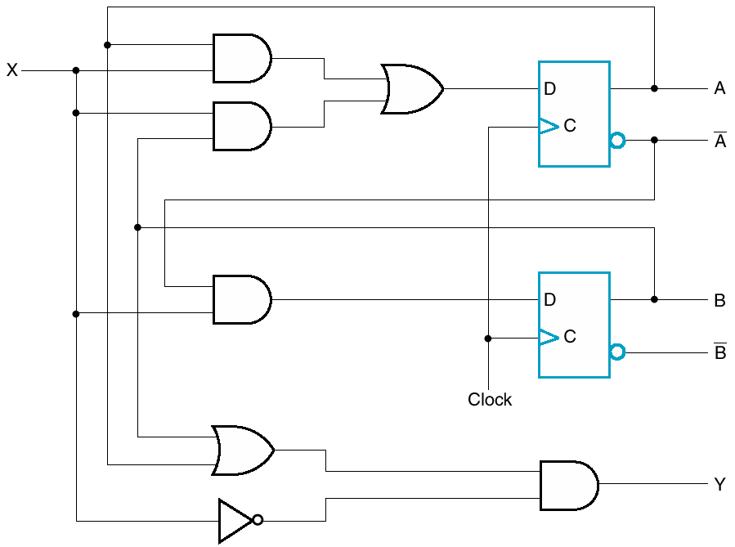
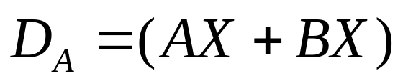
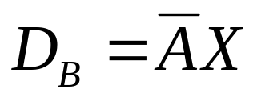
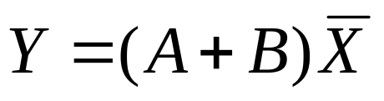
Analysis of Sequential Circuits
Can describe inputs to FF with logic equations

Slide 4
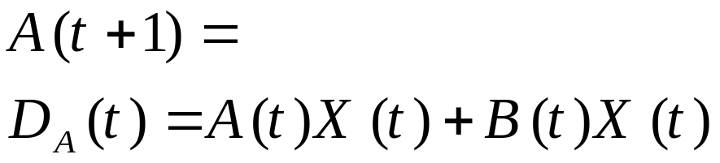
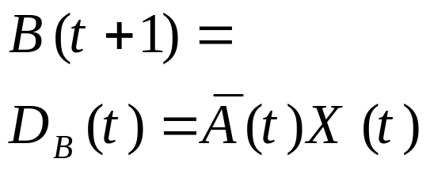
Analysis of Sequential Circuits
The current state {A(t), B(t)} & input X are used to determine next state {A(t+1), B(t+1)}

Slide 5
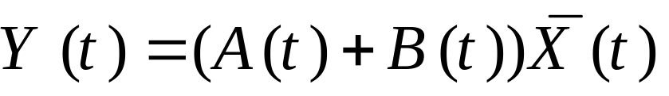
Analysis of Sequential Circuits
Current state & input X are used to determine output, Y

Slide 6
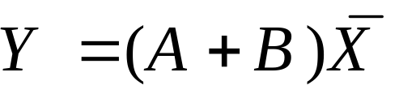
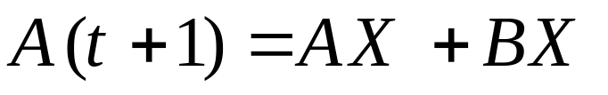
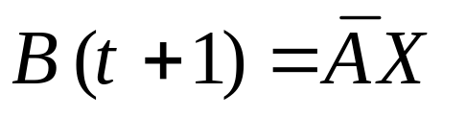
Analysis of Sequential Circuits

Slide 7
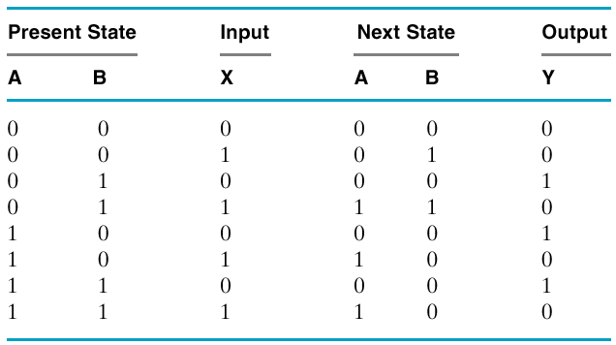


Analysis of Sequential Circuits
State Table
  Like truth table with states added
At time t+1
At time t+1
At time t
At time t

Slide 8
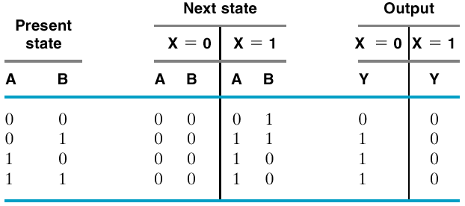
Analysis of Sequential Circuits
Same info, different layout style

Slide 9
Analysis of Sequential Circuits
State Diagram
  Alternative representation for state table
  Two Models
    Mealy Model
    Moore Model

Slide 10
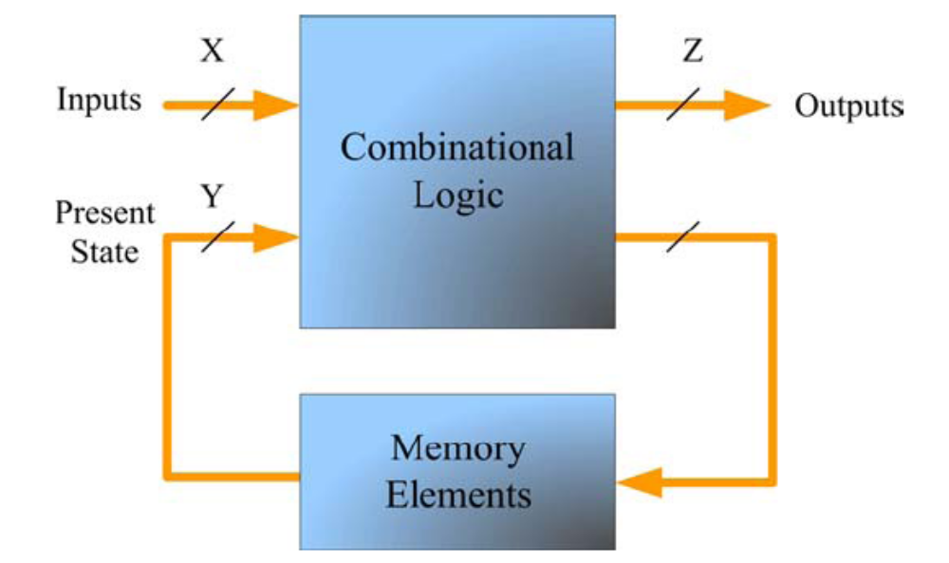
Moore and Mealy Machines
In Mealy machines the outputs are a function of the present state and the value of the inputs

Slide 11
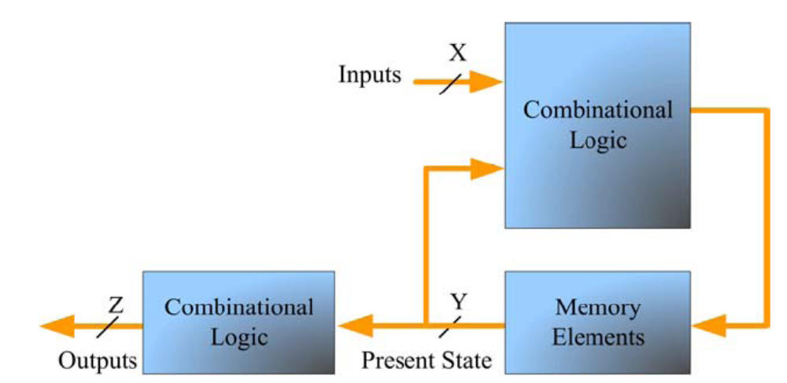
Moore and Mealy Machines
In a Moore machine the outputs depend only on the present state

Slide 12

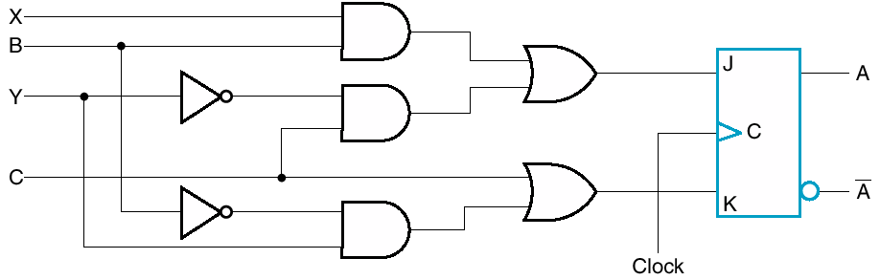
Moore and Mealy Machines
Moore model – outputs depend on states
Mealy model – outputs also depend on inputs

Slide 13
State Diagram
Mealy Machine: Output is associated with the current state and inputs
- Appears before the state transition is completed (by the next clock pulse).
Format:
Arc = input X
Node = state/output Q
Moore
0
1
A
B
0
1
0, 1
Mealy
1 / 1
Moore Machine: Output is associated with the state
Appears after the state transition takes place.
0/0
A
B
0 / 1, 1 / 0
Format:
Arc = input X / mealy output Y
Node = state

Slide 14
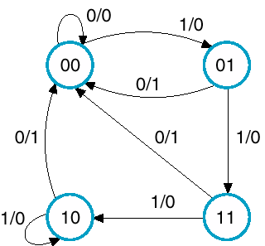
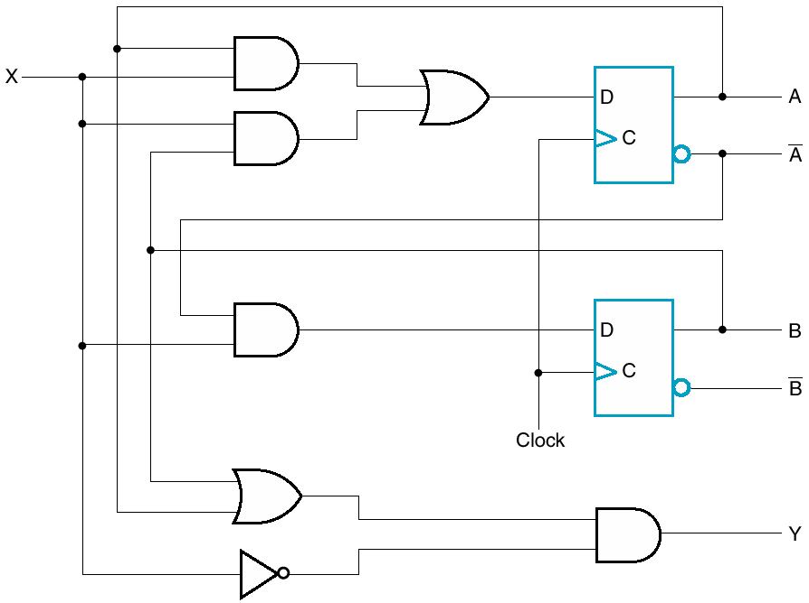
State Diagram – Mealy Model
Input/Output

Slide 15
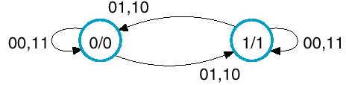
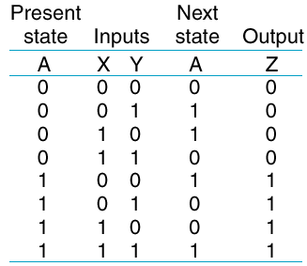
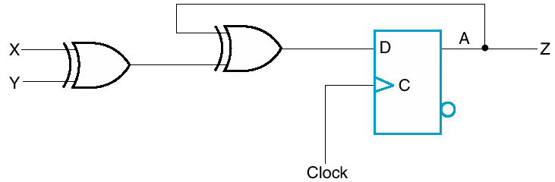


State Diagram – Moore Model
Inputs
State/Output

Slide 16
State Table vs Diagram
Same information
Table is perhaps easier to fill in from description
Diagram is easier for understanding and writing code
  You can label states with textual description

Slide 17
Designing State Machines
Specify the problem with words
  (e.g. Design a circuit that detects three consecutive 1 inputs)
Assign binary values to states
Develop a state table
Use K-maps to simplify expressions
  Flip flop input equations and output equations
Create appropriate logic diagram
  Should include combinational logic and flip flops

Slide 18
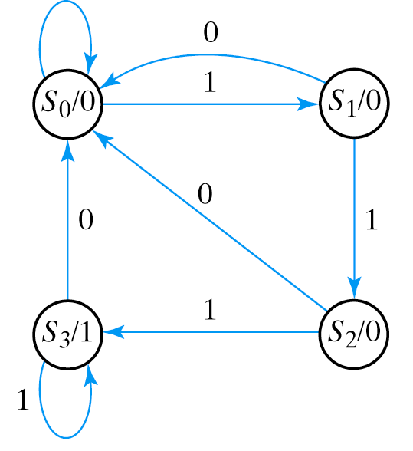
Example: Detect 3 Consecutive 1 inputs
State S₀ : zero 1s detected
State S₁ : one 1 detected
State S₂ : two 1s detected
State S₃ : three 1s detected
Note that each state has 2 output arrows
Two bits needed to encode state

Slide 19
State Table for Sequence Detector
Present
State
Next
State
Input
Output
A B x A B y
0 0 0 0 0 0
0 0 1 0 1 0
0 1 0 0 0 0
0 1 1 1 0 0
1 0 0 0 0 0
1 0 1 1 1 0
1 1 0 0 0 1
1 1 1 1 1 1
S₀ = 00
S₁ = 01
S₂ = 10
S₃ = 11

Slide 20
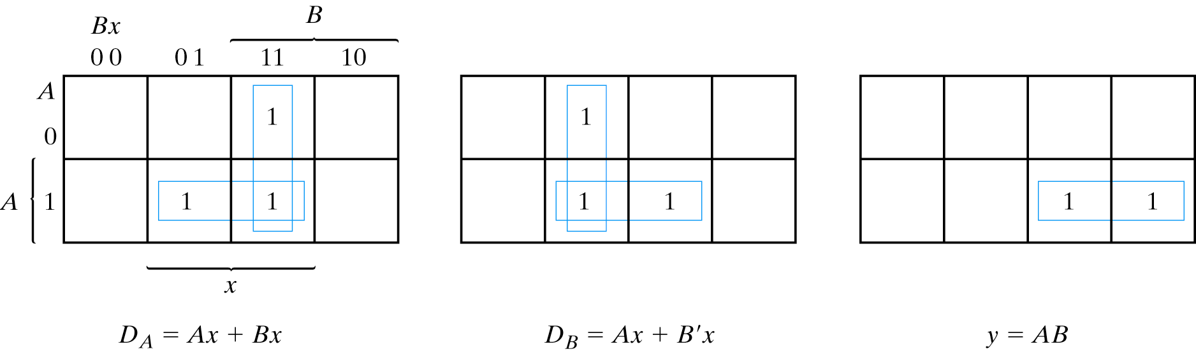
Finding Expressions for Next State and Output Value
Create K-map directly from state table (3 columns = 3 K-maps)
Minimize K-maps to find SOP representations
Separate circuit for each next state and output value

Slide 21
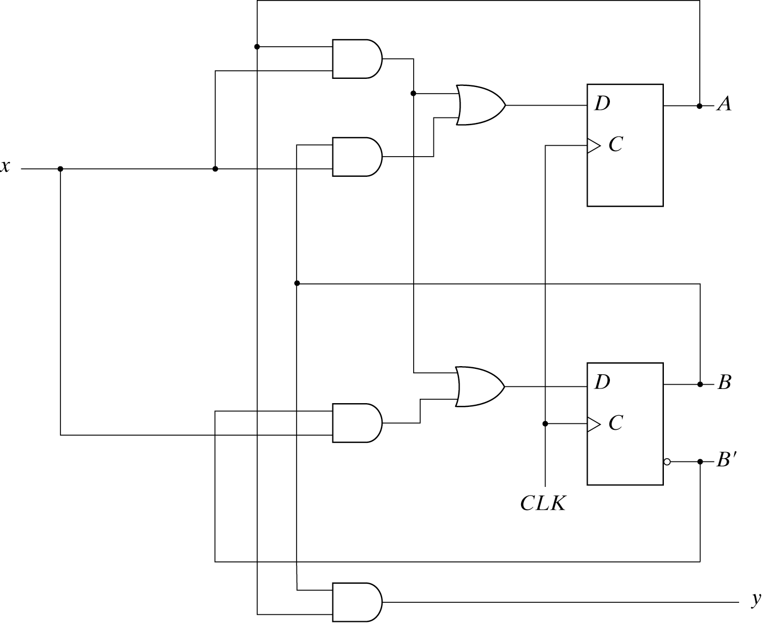
Circuit for Consecutive 1s Detector

Slide 22
Exercise
Design the same state machine using Mealy Model

Slide 23
Example 2
Circuit has input, X, and output, Z
Recognizes sequence 1101 on X
  Specifically, if X has been 110 and next bit is 1, make Z high
States remember past history
Clearly must remember we’ve seen 110 when next 1 comes along

Slide 24

Start State
Start state: let’s call it A
If 1 appears, move to next state B
Input / Output

Slide 25
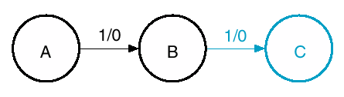
Second 1
New state, C
To reach C, must have seen 11

Slide 26
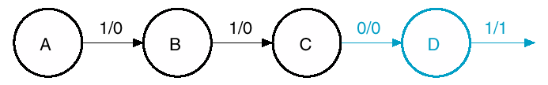
Next a 0
If 110 has been received, go to D
Next 1 will generate a 1 on output Z

Slide 27
What Else?
What happens to arrow on right?
Must go to some state.
Where?

Slide 28
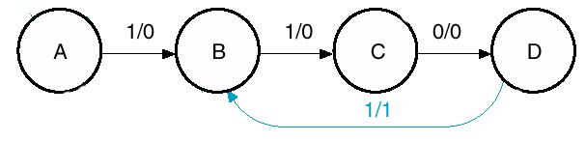
Where to go?

Slide 29

Cover every possibility
Must cover every possibility out of every state
In this case, X = 0 or 1
You fill in other cases

Slide 30
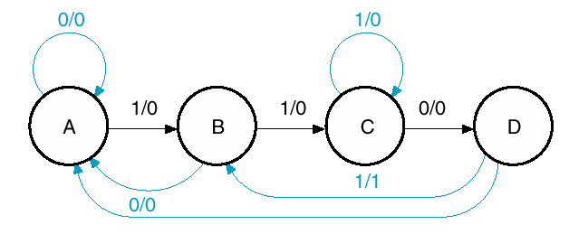
Cover every possibility

Slide 31
State Reduction
Reduce the number of states but keep the input-output requirements
Reducing the number of states reduces the number of flip-flops

Slide 32
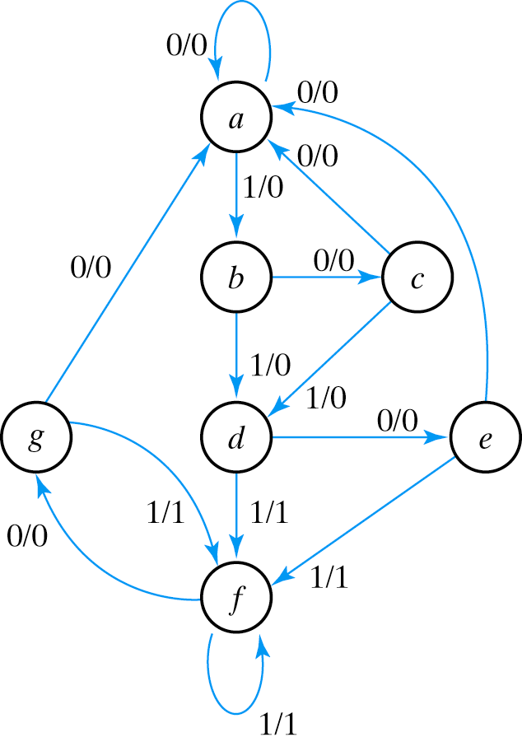
State Reduction – Row Matching
State Transition Table
NS output
PS x=0 x=1 x=0 x=1
a a b 0 0
b c d 0 0
c a d 0 0
d e f 0 1
e a f 0 1
f g f 0 1
g a f 0 1
Find the states for which the next states and outputs are the same

Slide 33
State Reduction – Row Matching
NS output
PS x=0 x=1 x=0 x=1
a a b 0 0
b c d 0 0
c a d 0 0
d e f 0 1
e a f 0 1
f g f 0 1
g a f 0 1
NS output
PS x=0 x=1 x=0 x=1
a a b 0 0
b c d 0 0
c a d 0 0
d e f 0 1
e a f 0 1
f e f 0 1
State g is replaced with e

Slide 34
State Reduction – Row Matching
NS output
PS x=0 x=1 x=0 x=1
a a b 0 0
b c d 0 0
c a d 0 0
d e f 0 1
e a f 0 1
f e f 0 1
NS output
PS x=0 x=1 x=0 x=1
a a b 0 0
b c d 0 0
c a d 0 0
d e d 0 1
e a d 0 1
State f is replaced with d

Slide 35
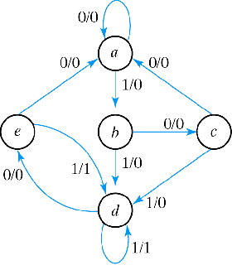
State Reduction – Row Matching
Reduced State Transition Diagram
NS output
PS x=0 x=1 x=0 x=1
a a b 0 0
b c d 0 0
c a d 0 0
d e d 0 1
e a d 0 1

Slide 36
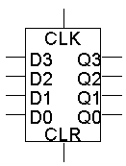
Registers
Basic registers are easy to build. We can store multiple bits just by putting a bunch of flip-flops together!

Slide 37
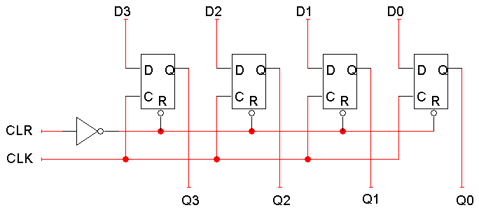
Registers
4 bit Register
  Uses D flip-flops, so it’s easy to store data without worrying about flip-flop input equations.
  All the flip-flops share a common CLK and CLR signal

Slide 38


Slide 39
References
Chapter 6 – Digital Design Morris Mano
Digital Logic and Computer Design – M. Singh, University of North Carolina
Latches & Flip-flops - Bobby Nazief
Material in these slides has been taken from, the following resources

